Slide 1


Social Buzz Popular Categories

Slide 2


Today's agenda
Project recap
Problem
The Analytics team
Process
Insights
Summary

Slide 3

Social media platform SOCIAL BUZZ has experienced rapid growth in the last 5 years, and they need help in scaling effectively. They are expecting:
An audit of their big data practice
Recommendations for a successful IPO
An analysis of their content categories that highlights the top 5 categories with the largest aggregate popularity
Project Recap

Slide 4

Problem
Over 100,000 posts a day
Over 500 million active users per month
So much data, so rapid growth, how to capitalize on it?

Slide 5



Andrew Fleming
Chief Technology Architect
The Analytics Team
Marcus Rompton
Senior Principal
Athiya Anindya
Data Analyst

Slide 6
Process
1
Data understanding
2
Data cleaning
3
Data modelling
4
Data analysis
5
Insights and recommendations

Slide 7
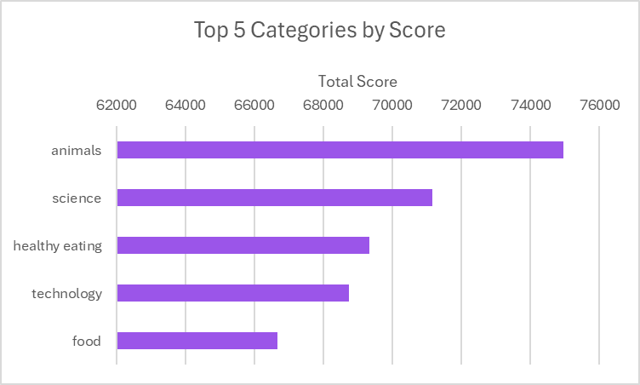

Insights

Slide 8
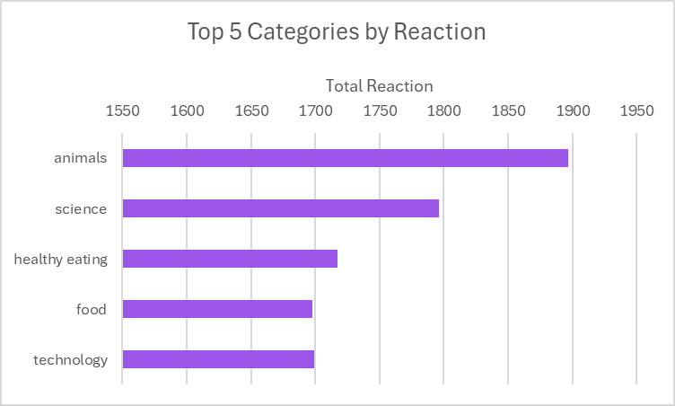

Slide 9
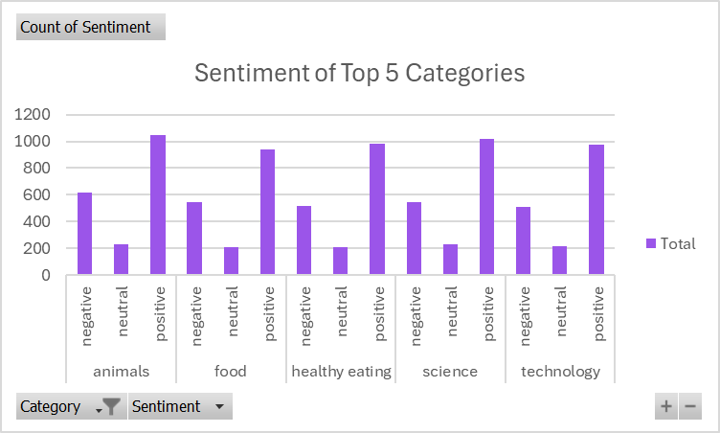

Slide 10
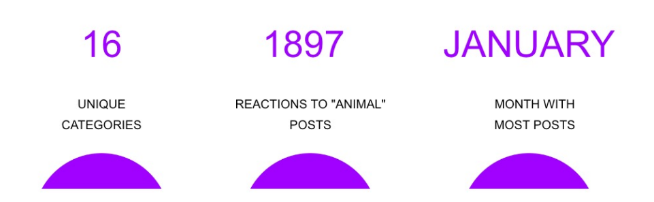

Slide 12

Summary
The most popular categories are:
Animals
Science
Healthy eating
Technology
Food
This list suggests that users like "real-life" and "factual" content.
Common theme amongst popular content and the most popular food category was healthy eating.

Slide 13
Thank you!
ANY QUESTIONS?

